Slide 1
Get Your TILT ON
Definition of Transparency in Teaching and Learning (TILT)
Research Based – TILT
TILT-ing through Assignment Charrate
Value of Student Agency in TILT-ing Higher Ed.
Questions & Discussion
Toni Kathleen Tsai-En
Notes:
Kathleen

Slide 2
211 TILT GET YOUR TILT ON
1. Recognize the connection between transparent assignment design, equity and closing opportunity gaps
2. Use the TILT method to work on a revised draft of an assignment
3. Identify ways you can engage students in the TILTING process to increase student agency
4. Leave with access to resources in a shared Canvas classroom to TILT on your campus
Notes:
Kathleen

Slide 3
What is TILT?
Transparent teaching and learning methods (TILT) focus on how and why students are learning course content how they’ll use that learning in their lives after college.
TILT method benefits students who are unfamiliar with college success strategies by explicating learning/teaching processes.
Greater benefits for systemically non-dominant and first-generation students
*“Systemically Non-Dominant Populations,” coined by Deb Jenkins. See this article explaining the term.
Winkelmes, MA. “Transparency in Teaching: Faculty Share Data and Improve Students' Learning.” Liberal Education 99, 2 (Spring 2013).
Notes:
Tsai-En
•“A 2013 study identified transparency—engaging teachers and students in focusing together on how college students learn what they learn and why teachers structure learning experiences in particular ways—as a teaching method that showed promise for improving underserved students’ educational experiences in college (Winkelmes, 2013).”

Slide 4
Assignment Design in TILTING
Faculty make small changes, aka “tweaks,” to assignments in 3 key ways to improve transparency in assignment creation:
Purpose: Knowledge gained, skills practiced, importance to the learner 5 years from now
Task: What steps to take (what steps not to take)
Criteria: What success looks like
Notes:
Kathleen

Slide 5
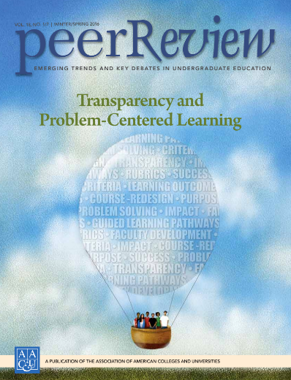
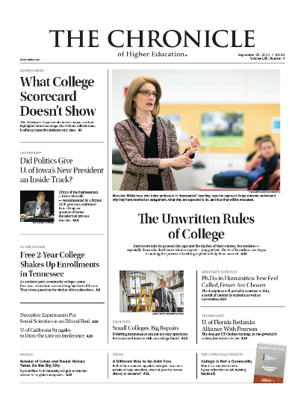
Credit: Mary-Ann Winkelmes, Ph.D.
Director, Instructional Development & Research, UNLV
Senior Fellow, Association of American Colleges & Universities
Nevada Humanities Board of Directors member Founder and Principal Investigator
Notes:
Tsai-En
The transparency started in ESL field. Mary-Ann Took it cross discipine.
Results for all students when TILT-ing 2 outside-of-class, assignments in 1 course 1 quarter:
Qualitative: Statistically significant increases in academic confidence, sense of belonging, sense of perceived transparency, sense of gaining employer-valued skills.
Quantitative: The students who received transparent instruction had 13% to 15% higher retention rates not just 1 year later . . . but 2 years later.

Slide 6
Opportunity Gap Frame Work (Milner, 2010)
Color Blindness
Cultural Conflicts
Meritocracy
Low Expectations
Context Neutral Mindset
Notes:
Tsai-En
Equity Gaps are NOT Caused by Student Learning Problems

Slide 7
Paradigm Shift
Shift your mindset to EQUITY.
Notes:
Tsai-En: When we talk about equity, historically, we have talked about student learning problems. You can’t just adopt best practices-- you have to

Slide 8
Equity Gaps are NOT Caused by Student Learning Problems
….I view inequality in educational outcomes as a learning problem of institutional actors— faculty members, administrators, counselors, and others—rather than as a learning problem of students... (Garmoran and others, 2003).
Estela Mara Bensimon in Closing Achievement Gaps in Higher Education,
Notes:
Kathleen
“…the persistence of unequal educational outcomes for racial and ethnic groups with a history of past discrimination in postsecondary education.

Slide 9
What About the Faculty Role?
Notes:
Kathleen There has been little systematic study of the role that faculty can play collectively in improving learning outcomes and success for systemically non-dominant students

Slide 10
Student Impact
When assignments are transparent, students are more likely to complete the assignment.
Students will gain college readiness skills.
Involving students in TILT gives opportunities for students to learn job readiness skills.
Notes:
Kathleen

Slide 11
Increased Access DOES NOT EQUAL Equity
Now for the DATA...
Notes:
Toni
What relevant data shows the need for transparency as a teaching method? Response: Devin Dupree, Research Policy Associate, looked at the percent of students who completed a course with a grade of 2.0 or higher in the most popular Common Course Number (CCN) courses in 2016-17.

Slide 12
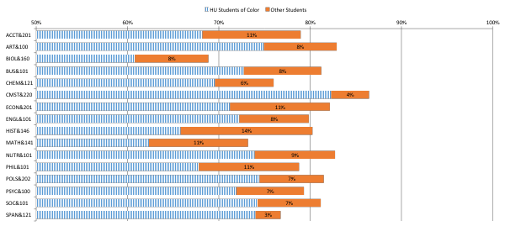
Relevant Data for Transparency as a Teaching Method
Notes:
Toni
From Research Brief: http://bit.ly/2CfzexZ
Sample look at courses. You might be looking at more local data on your campus.
Explain, this graph shows the percentage of students who completed a course with a grade of 2.0 or higher in the most popular Common Course Number (CCN) courses in 2016-17.
For example, in Accounting 201, the blue bar shows that under 70% systemically non dominant students completed the course with a 2.0 or higher . . . The orange bar shows the gap-- so other students completed at just under 80% meaning they were, as a group, 11% successfully complete the course. If you use that to predict the future, they are 11% less likely to complete the course– IF NOTHING CHANGES.
These are gaps within the system. If we filled those gaps in these courses, we’re talking about hundreds of students. And at an individual course level, you’re talking about 1 or 2. The only way to fill the gaps are going to be small changes happening across several courses.

Slide 13
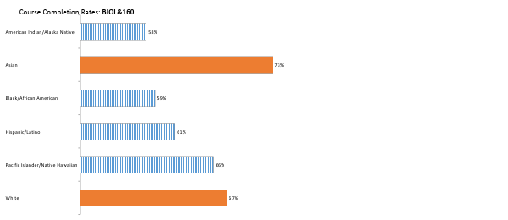
System Level Course Data BIOL&160, Disaggregated
Notes:
Toni
This shows a little bit more detail for one course. So this breaks down that blue bar so systemically nondominant students we are talking about– American Indian/Alaska Native . . .
Other students are those identifying as Asian or white. Some who don’t report race or ethnicity.
Clarify this does include small overlap because we categorize students under each race/ethnicity they report, so some students are showing up in more than one bar.
So in the last one, when you combine all the students together, if a student identifies as a systemically non dominant, they are counted a systemically non dominant, while other students are systemically dominant. The take away is that there are NOT duplicates in the chart before but there are in the previous chart.

Slide 14
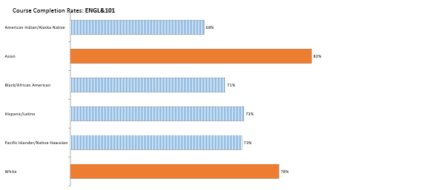
System Level Course Level Data, ENGL&101, Disaggregated
Notes:
Toni

Slide 15
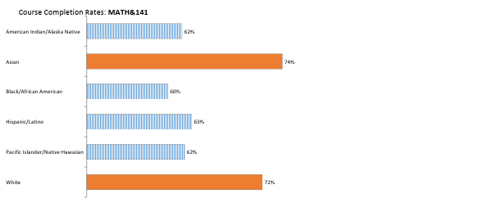
System Level Course Level Data, MATH&141, Disaggregated
Notes:
Toni

Slide 16
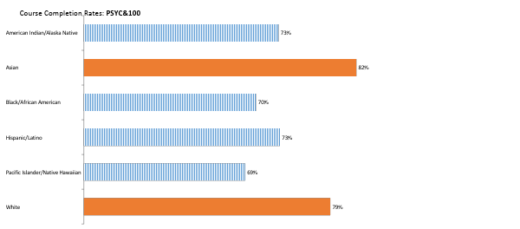
System Level Course Level Data, PYSC&100, Disaggregated
Notes:
Toni
As you scroll, there are patterns that show up very consistently. The patterns are strong enough that they show up in different ways.
What can you do about it? You are here. We are TILTing

Slide 17
Crunch the Data
As a system, these 10’s or 100’s of students in each course add up to thousands of students.
5,000 more students successfully completing all of their courses in a school year
1,000 more students leaving college with a credential or transfer to a four year institution in a school year
Notes:
Toni

Slide 18
What can we do about it?
We are Here. We are TILTING.
Notes:
Toni

Slide 19
When an Assignment Goes Wrong
If a student receives a D in your course, are you in any way responsible?
Notes:
Tsai-En If an assignment doesn’t yield the results you had anticipated, what is it that causes it to do so?

Slide 20
More than 700 Instructors said…. (Cengage)
The factors of student success are …
•Motivation and dedication
•Engagement
•Organization and time management
•Preparation
•Belief in their own ability to succeed
•Participation Tami Strang(2015) Student Success: Instructors Describe the Top Factors. Posted in: Engagement and Motivation. Cengage, Retrieved from https://blog.cengage.com/student-success-instructors-describe-top-factors/
Notes:
Tsai-En

Slide 21
Assignments
Opportunity?
Or
Opportunity Missed?
Notes:
Tsai-En

Slide 22
Transparent Design Template
Purpose
Skills practiced ------------ long term relevance to students’ lives
Knowledge gained---------connection to learning outcomes
Tasks
What students will do
How to do it (steps involved)
Mistakes to avoid
Criteria for success
Checklist or rubric in advance so students can self-evaluate
What excellence looks like (annotated examples)
Winkelmes et al, Peer Review (Winter/Spring, 2016)
Notes:
Kathleen

Slide 23
Purpose
To consider the importance of transparently designed, take-home assignments on the learning experiences of all students.
Notes:
Kathleen
One of the 5 active learning types/strategies . . . That we have called in our academic plan for good assessment . . . Better assessment.

Slide 24
Tasks
Compare a less transparent (non-TILTED) with a more transparent (TILTED) assignment with a peer
Complete eight timed steps following instructions for each step
Work with a disciplinary stranger to TILT within specific roles to give feedback
Avoid stepping out of your role as listener to explain, defend or add to your partners understanding of the assignment.
Notes:
Kathleen

Slide 25
Criteria for success
Leave with a clear idea of one small tweak that you can make to the assignment you workshopped today with your “Disciplinary Stranger” that you can go home and make tonight.
Identify 1-2 ways to TILT with students
Locate resources to TILT in your classroom and share
Notes:
Kathleen

Slide 26
What is an assignment charrette?
Notes:
Kathleen ...an intense period of design or planning an activity

Slide 27
The Practice
EXAMPLE: Less Transparent 1 min
What is the purpose of the assignment?
What skills will be practiced and why are they important?
What knowledge will you gain that will help you become familiar with the content in this discipline?
Compare the Less Transparent with More Transparent Assignment 1 min
Notes:
Kathleen

Slide 28
Step 1
Choose an assignment from the middle of the quarter
when students are acquainted with, and applying,
the basic tools and terminology of the course.
Notes:
Kathleen

Slide 29
Step 2
Sit with a disciplinary stranger
Notes:
Toni
Good Professional development 2. Transparent and reflective practice 3. Powerful learning in collaboration 4. Get us out of department silos

Slide 30
Roles
As a novice student…
Respond to the prompts for each phase as a novice student.
As the author…
Listen and observe. Do not coach or explain.
Notes:
Kathleen: Student: purpose, task and criteria. You may talk through the prompts and/or make notes on your partners’ assignment.

Slide 31
Step 3
Describe Your Assignment
2 MINUTE EACH
Notes:
Kathleen

Slide 32
Step 4
Feedback on the Purpose
As a novice student, offer feedback on the Purpose (2 min per assignment)
Notes:
Kathleen

Slide 33
Feed Back Questions
Five years after taking this course:
what essential knowledge will I, as a student, retain from doing this assignment?
what skills will I, as a student, be able to perform because I will practice doing this assignment?
as a student, how can use these in my life beyond the context of this course and beyond college?
(2 min per assignment)

Slide 34
Step 5
Reflection on Purpose 2 minutes
Notes:
Kathleen Jot down any additional thoughts/ideas for your draft

Slide 35
Step 6
Feedback on TASK
As a novice student, offer feedback on the TASK
(2 min per assignment)
As a novice, Make a running list or talk through the first through the last steps of submitting the assignment.
As the author, Listen. Do not guide, coach or respond.
Notes:
Kathleen

Slide 36
Step 7
Feedback on Criteria
As a novice student, offer feedback on the Criteria
(2 min per assignment)
As a novice:
Are you confident you are doing the task effectively?
Are you confident you are doing excellent work?
Do you have annotated good examples
To answer yes, what would you need?
Notes:
Kathleen

Slide 37
Step 8
Notes:
Kathleen Total 4 minutes

Slide 38
Student Agency in TILT-ing
Notes:
Tsai-En

Slide 39
What do Students Value?
Ability to be successful in learning?
Guessing or Mind Reading?
Notes:
Tsai-En -or-

Slide 40
Odessa College (Round 1)
What impacts student success?
Subject
Course
Time of Day
Rigor
Preparedness
NOPE
Kistner, N.A., & Henderson, C.E. (2014). The drop rate improvement program at Odessa College. Achieving the Dream’s Technology Solutions: Case Study Series. Retrieved from http://achievingthedream.org/resource/13784/the-drop-rate-improvement-program-at-odessa-college
Notes:
Tsai-En

Slide 41
Odessa College (Round 2)
What impacts student success?
Teaching Methods
NOPE
Kistner, N.A., & Henderson, C.E. (2014). The drop rate improvement program at Odessa College. Achieving the Dream’s Technology Solutions: Case Study Series. Retrieved from http://achievingthedream.org/resource/13784/the-drop-rate-improvement-program-at-odessa-college
Notes:
Tsai-En

Slide 42
Quote about Student Success
“A common thread of connectivity to their students.”
Dr. Donald Wood, Vice President for Institutional Effectiveness, Odessa College
Kistner, N.A., & Henderson, C.E. (2014). The drop rate improvement program at Odessa College. Achieving the Dream’s Technology Solutions: Case Study Series. Retrieved from http://achievingthedream.org/resource/13784/the-drop-rate-improvement-program-at-odessa-college
Notes:
Tsai-En

Slide 43
Odessa College: In-Class Retention
Before
After
83%
95%*
*“regardless of gender, age, race/ethnicity, or Pell status”
Kistner, N.A., & Henderson, C.E. (2014). The drop rate improvement program at Odessa College. Achieving the Dream’s Technology Solutions: Case Study Series. Retrieved from http://achievingthedream.org/resource/13784/the-drop-rate-improvement-program-at-odessa-college
Notes:
Tsai-En
Results for all students when TILT-ing 2 outside-of-class, assignments in 1 course 1 quarter:
Qualitative: Statistically significant increases in academic confidence, sense of belonging, sense of perceived transparency, sense of gaining employer-valued skills.
Quantitative: The students who received transparent instruction had 13% to 15% higher retention rates not just 1 year later . . . but 2 years later.

Slide 44
TILT-ing is Connecting
TILT-ing is connecting and engaging
Connect Trust with TILT
Responding to diverse students’ needs
TILT-ing allow students to have a tool to engage conversation with a faculty.
Notes:
Tsai-En
Equity Gaps are NOT Caused by Student Learning Problems

Slide 45
TILT Address the Issues Raised by Students
Support sense making: A clear statement of the purpose for the assignment in the course and connected to the future.
Provide clarity: A transparent procedure on how to complete assignments properly.
Set Goals: A clear expectation and allow students to self-check their performance.
Notes:
Tsai-En

Slide 46
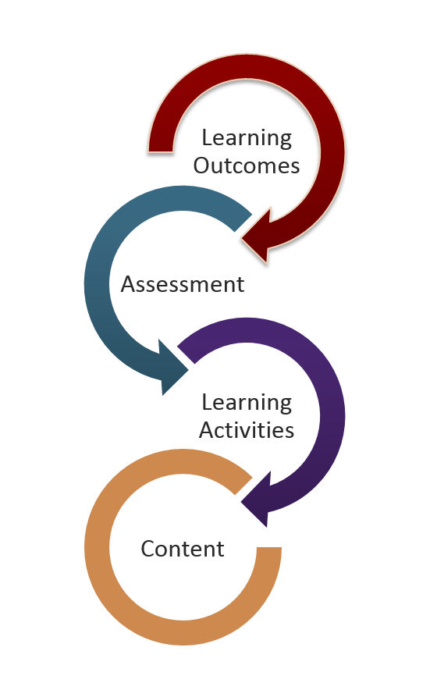
IDEAS FOR TILT-ing
WITH STUDENTS
Backwards Design
Notes:
Tsai-En

Slide 47
TILT with Student Idea #1
Give your less transparent assignment to students.
Ask students to identify the purpose, task, and criteria.
For each, discuss what is already present and what they would add.
Upload the class’s more transparent version to Canvas.
Sally Heilstedt (Lake Washington Tech)
Notes:
Tsai-En
TILT with Student Idea #1 Sally Heilstedt
Instead of editing all of your assignments, choose just two higher stakes assignments towards the beginning of the quarter. Then, later in the quarter walk through an assignment with the class and ask students to do the activity we did at the beginning of this session: identify the purpose, task, and criteria.
Share the student version of the Transparent Assignment Template in your folder.

Slide 48
TILT with Student Idea #2
Ask students to find exemplars.
Form small groups.
Each group selects an exemplar, annotates it, and presents or shares it with the class Sally Heilstedt (Lake Washington Tech)
Notes:
Tsai-En
As part of the Criteria section, provide students with annotated examples of successful work.
Use real-world examples (as opposed to previous student work) whenever possible
Annotate an example with your students in class
Ask students to find and annotate an additional example as part of the assignment

Slide 49
TILT with Student Idea #3
Provide students an transparent assignment with Purpose, Task and Criteria without Rubric.
Provide students two exemplars with different quality.
Ask students to work in small groups to create a rubric based on Purpose and Criteria.
Let students vote what will be on the rubric.
Finalize the rubric in class. Tsai-En Cheng ( Seattle Central College)
Notes:
Tsai-En
As part of the Criteria section, provide students with annotated examples of successful work.
Use real-world examples (as opposed to previous student work) whenever possible
Annotate an example with your students in class
Ask students to find and annotate an additional example as part of the assignment

Slide 50
The “Do’s” When TILT-ing with Students
Give Students exposure to at least 2 transparent assignments in your class before they TILT with instructor.
Intentionally Remember the purpose of involving student TILT-ing the assignments.
Inclusive Be a good listener
Encourage discussion and allow students’ perspective to be different then the instructor
Notes:
Tsai-En

Slide 51
Students will thank you
“I would be able to do what I am supposed to instead of guessing and then getting the wrong idea.”— Student, Spokane Community College
Notes:
Tsai-En

Slide 52
Canvas
Templates + Duplicate
Notes:
Kathleen

Slide 53
Remember our Objectives?
1. Recognize the connection between transparent assignment design, equity and closing opportunity gaps
2. Apply the TILT framework to revise existing assignments
3. Identify ways you can engage students in the TILTING process to increase student agency
4. Locate resources in a shared Canvas classroom to TILT on your campus
Notes:
Kathleen

Slide 54
Resources and Contact
Canvas Public Course TILT-Transparency in Learning and Teaching
Full URL: https://canvas.northseattle.edu/courses/1734110
North Seattle College Kathleen Chambers 206-934-3681
Kathleen.chambers@seattlecolleges.edu
North Seattle College Toni Anderson 206-934-4522 Toni.Anderson@seattlecolleges.edu
Seattle Central College Tsai-En Cheng 206-934-5499 Tsai-En.Cheng@seattlecolleges.edu

Slide 55
A thought…
How do I make this course, this subject matter, useful for someone who will never take this course again?
Now….Get your TILT on……..
Notes:
All Three

