Slide 1
Working with Automatic Closed Captions in Panopto
North's eLearning Support Center

Slide 2
Automatic Closed Captions
Automatic Captions are not 100 % accurate and require some editing by the creator of the video. We highly encourage you to make use of closed captions in your videos, there are numerous reasons why closed captioning your videos is important.
You have other options around automatic captions.
The following are some options you have with Panopto Automatic Captions:
You can turn them off during viewing
You can delete automatic captions
Stop Panopto from adding automatic captions in your videos.

Slide 3
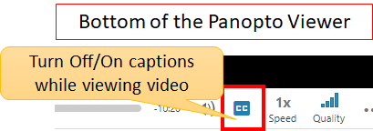
Turning Closed Captions Off/On During Viewing
Whether you are watching a video in the Panopto viewer or embedded in a Canvas page, viewers can turn off/on closed captions by clicking on the closed caption symbol found at the bottom of the playback area.

Slide 4
Deleting Closed Captions for a Single Panopto Video
As a Panopto creator (usually the instructor), you can delete the automatic closed captions in a single Panopto video by going to the settings area:
Click on settings
Select captions
Click on Default at the top
Click on Delete Captions.

Slide 5
Stopping Panopto’s Automatic Captions in a Folder
As a Panopto creator (usually the instructor), you can stop Panopto from adding automatic closed captions into videos at the folder level. When you stop automatic captions in a folder, all the videos inside the folder will be affected by that change.
Click on the folder settings
Click on the settings tab to the left
In the Captions are in the middle of the page, select None

