Slide 1
Zoom Management
Recording/Sharing
Accessibility
Security
North’s eLearning Support Center

Slide 2
Zoom Management
Let’s take a look at account settings for Education

Slide 3
Checklist Zoom for Education Part 1
Before Meeting
During Meeting
After Meeting
Settings
Host/Participant video OFF
Join before host OFF
Mute Participants upon Entry ON
Chat ON
Private Chat ON/OFF Optional
Auto-Saving chats ON
File Transfer OFF
Co-Host (If co-teaching) ON
Polling ON
Always show meeting Control Bar ON
Screen Sharing (Host Only) ON
Annotation ON
Whiteboard ON
Nonverbal Feedback ON
Breakout Room ON
Waiting Room ON
Allow removed Participants to rejoin OFF
Netiquette
Join your meeting as the host
Remind students how to participate: Chat, nonverbal feedback, raise hand
Check chat for questions and comments
Manage Participants: Place students in/out of waiting room, remove participants if needed, mute/unmute all
If co-teaching, assign co-host
Lock your Zoom meeting after all participants have arrived
Only you as the host can share your screen. Unlock during meeting so others can share if needed
Breakout rooms are not recorded. Recording works for the main room.
Assign a student to record to their computer if you want a recording of each breakout room.
Recordings & Attendance
Recordings to the Cloud are found in Zoom cloud on Zoom's website and Panopto folder "meeting recordings"
Edit captions/transcripts before sharing with students
Share the Panopto recording with students by changing the who has access.
Recordings to the Computer live locally on computer where the host recorded. Upload and share the video file from OneDrive/ Google Drive or Panopto.
Get an attendance record from Zoom reports on Zoom's website. File can be exported to Excel.

Slide 4
Checklist Zoom for Education Part 2
Before Meeting
During Meeting
Schedule your meetings with a unique URL. Keep your personal meeting URL, which is permanent for office hours or faculty meetings
Prevent Removed Participants from Rejoining a Meeting
In your Zoom account settings, disable "Allow Removed Participants to Rejoin" so booted attendees can't re-enter the meeting. Settings > Meeting > In-Meeting (Basic)
See: Account Settings
Password Protect Your Meeting
Require a password for entry to a Zoom meeting. To do this, enable three settings in your Zoom user account:
"Require a password when scheduling new meetings",
In addition, be sure to disable the setting called "Embed password in meeting link for one-click join". This means you will have to provide the password in a separate communication from the meeting link. This is less convenient but is a deterrent to unwanted visitors.
See: Require a Password
See: Account Settings
Only Allow Participants in the Room When You are There
When setting up the meeting, be sure to disable "Join before host", so that the meeting can only be in progress when you, the host, are present. You can disable this in the meeting settings when you are creating the meeting. You can also disable this for all your meetings, if you choose, in your Zoom user account settings.
See: How do I set up a meeting directly in Zoom?
See: Account Settings
Prevent Participants from Transferring Files
Disable In-Meeting File Transfer in your Zoom account settings, so there's no digital virus sharing.
See: In-Meeting File Transfer
Join Your Meeting as the Host
When you start up your Zoom meeting, make sure you start it as the host, rather than clicking the invitation link and joining as a participant.
See: How do I set up a meeting directly in Zoom?
Include a Co-Host in your Meeting
Enabling Co-Host so you can assign others to help moderate.(This is the default setting, and users who are "alternate hosts" will also join the meeting as a Co-Host by default)
See: Enabling and Adding a Co-Host
See: Host and Co-Host Controls in a Meeting
Lock Your Zoom Meeting After All Participants Have Arrived
Once all attendees have arrived, you can 'lock' the meeting via the participant list. This is analogous to locking a physical door to the classroom.
See: Managing Participants in a Meeting
Only You as Host Can Share Your Screen
As host of a Zoom meeting, you can prevent all other participants from sharing their screen.
See: Managing Participants in a Meeting
See: Sharing Your Screen
Eject a Problem Visitor from the Zoom Meeting
Identify the problem user and use "Remove" in the Participants window to dismiss them permanently from the meeting. Just be sure to remove the unwanted user, not wanted participants.
See: Managing Participants in a Meeting
Lock down the chat
Teachers can restrict the in-class chat so students cannot privately message other students. We’d recommend controlling chat access in your in-meeting toolbar controls (rather than disabling it altogether) so students can still interact with the teacher as needed.
See: How to control chat access

Slide 5
Check your account settings often.
There are new security measures taking place daily/weekly

Slide 6
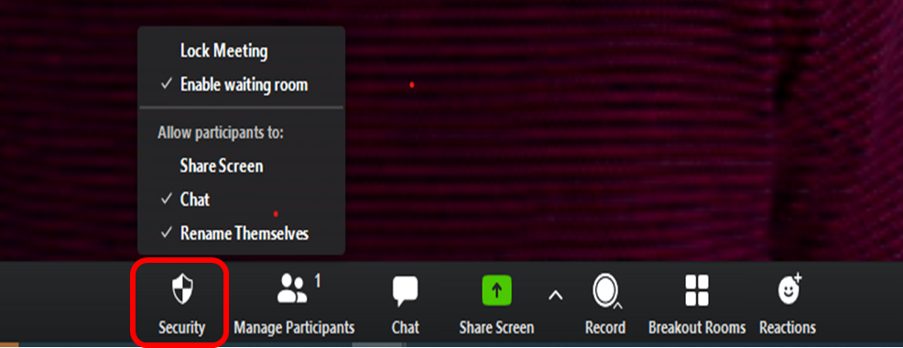
Security Shield on Host Controls

Slide 7
Meeting Passwords
Lowercase letters, uppercase letters, numbers, special characters
Zoom requires up to 10 character password
Participants will be asked for this password in order to join your meeting.

Slide 8
Enable Waiting Room
Waiting Room requires more work by the host, but only allows participants to join if specifically admitted
One by one or admit all
To turn off the Waiting Room feature while in a meeting, in the Participants pane, click More and uncheck Put Attendee in Waiting Room on Entry

Slide 9
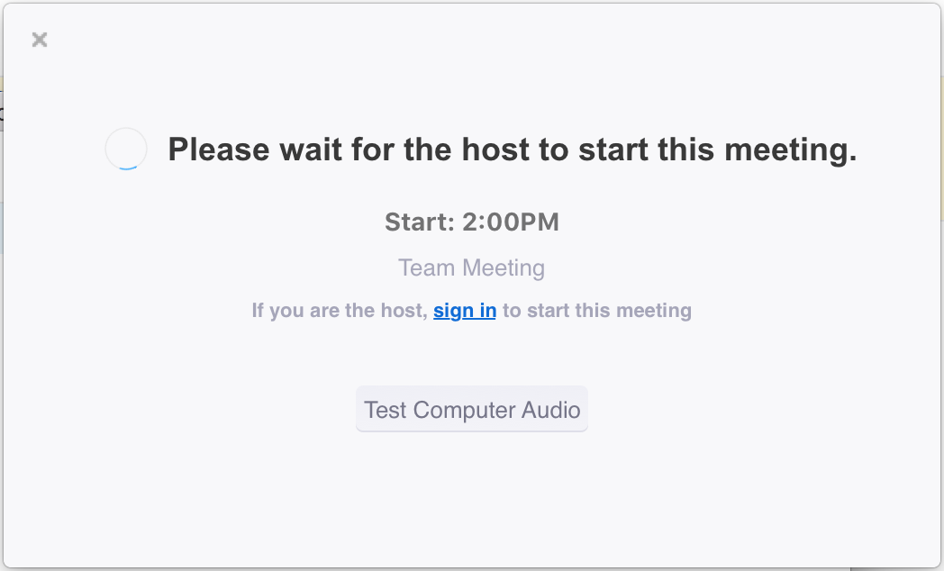
Disable Join before Host
Make sure you are in the room when students are present
It can be disabled at the account level and
It can be enabled/disabled for individually scheduled meetings

Slide 10
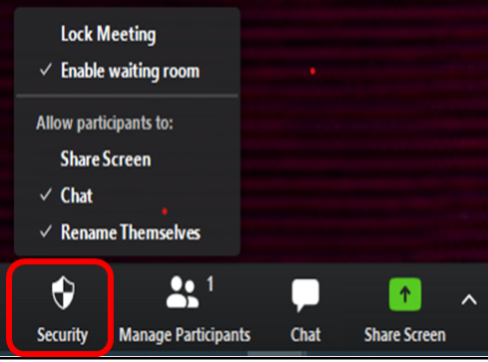
Limit Screen Sharing to the Host Only
Now by default, screen sharing in Zoom meetings is limited to the host.
Use security shield or the up arrow next to screen share to allow attendees to share their screen.

Slide 11
Lock your Meeting
To Lock the Meeting:
Open Manage Participants
At the bottom of the Participants panel, click More.
From the list that appears, click Lock Meeting.
To Unlock the Meeting:
Follow the same steps as above and choose Unlock Meeting

Slide 12
Chat Public or Private?
Check your account settings
During the meeting, control who participants can chat with.
No one: Disables in-meeting chat
Host only
Everyone publicly
Everyone publicly and privately

Slide 13
Zoom Security and Data Handling Resources
Zoom’s Privacy Policy
The Facts around Zoom and Encryption for Meetings
Attendee Attention Tracking Removed
Message to Users by CEO Eric Yuan
Security at Zoom
Zoom Security WhitePaper

Slide 14
Zoom Recording and Sharing

Slide 15
Zoom Recording
Record to the Cloud
Zoom recording integrated with Panopto
Found in My Folder > Meeting Recordings
Record to the Computer
Locally stored: My Documents > Zoom Folder > Zoom_0.mp4.

Slide 16
Accessibility
Zoom Accessibility Documentation
Transcripts, keyboard shortcuts,screen reader support
Panopto Accessibility Documentation
Closed captions, keyboard navigation, screen reader support, variable play speedback
Zoom
Panopto

