Slide 1

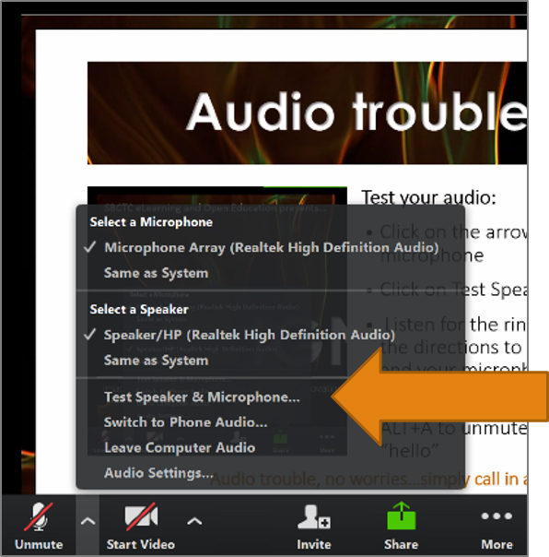
Test Your Audio
Click on the arrow to the right of the microphone
Click on Test Speakers & Microphone
Follow the directions to test your speakers and your microphone
Click on the microphone icon (ALT+A) to unmute and say “hi”
Notes:
We’ll get started today with a very brief overview of Zoom and a few other housekeeping items.
First thing on the list is to check your audio.
If you haven’t already done so, you may need to press the Esc key to exit full screen view and find the audio menu.
If you are experiencing audio trouble or do not have a headset or speakers, you can call in by phone at
+1.669.900.6833 (US Toll) and enter Meeting ID 403 634 541#

Slide 2
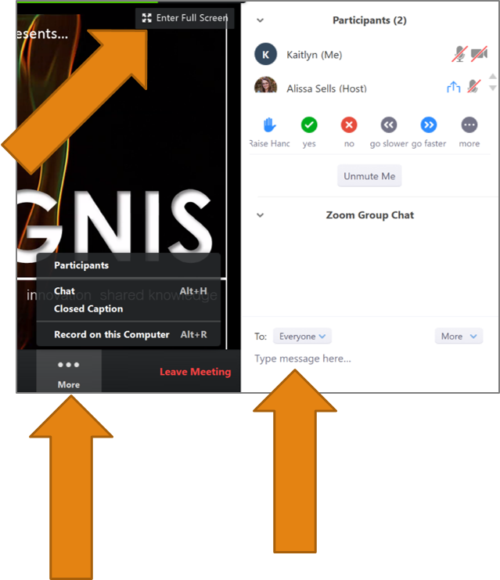
Participant Tools
Click on More in the Zoom toolbar to add the Participants panel and Chat panel to your view.
Type your questions and comments into the Zoom Group Chat.
Choose EVERYONE
For a full screen view, click on Enter Full Screen
Click on Esc to exit full screen.
Notes:
You can find the list of participants and the participant tools in the Participants panel near the top right of your screen and the Chat panel is near the bottom right of your screen.
If you don’t see them, click on More in the Zoom toolbar at the bottom of your screen and then on Participants or Chat to add them into y our view.
Please type your comments and questions into the Zoom Group Chat as we go or raise your hand to ask a question. Be sure to select ‘Everyone’ from the drop down menu when sending a message.
We may need to hold a few of the questions until the end, so please be patient!
For a full screen view, click on Enter Full Screen and exit by clicking on Esc

Slide 3
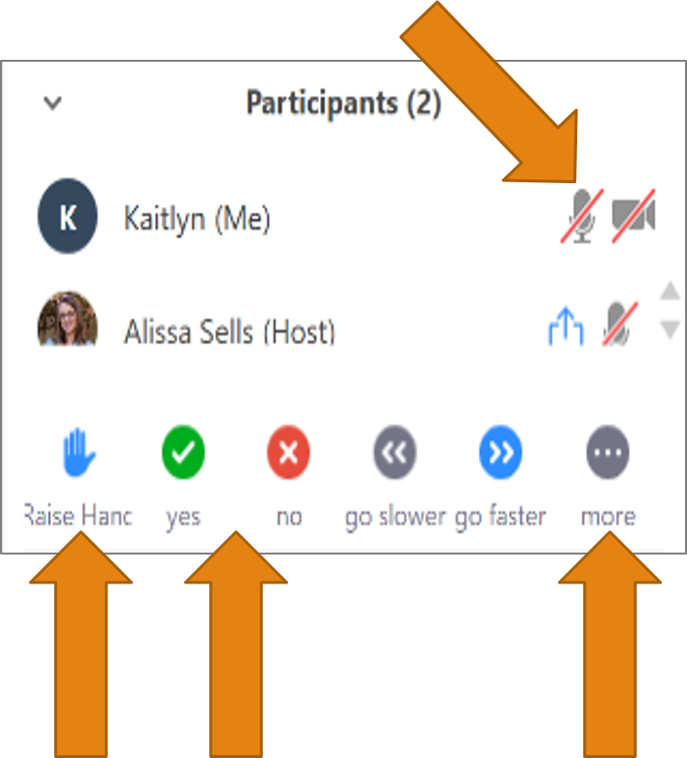
Participant Panel Tools
Click the Microphone icon to mute and unmute yourself.
Click on Raise Hand to ask a question.
Click yes (green check) or no (red x) to answer questions.
Click more to clap or give a thumbs up.
Notes:
You will find the Participant tools in the Participants panel.
You can raise your hand to be called on and when it’s your turn to speak, simply click the Microphone icon to unmute your mic.
To cut down on background noise, please keep your mic muted when not speaking.
Please also turn your cameras off to help save on bandwidth.
Click the Camera icon in the Participants tools to turn your camera on and off.
If you click on more, can give applause or a thumbs up.

